Slide 1
International education week
Polish Video Game Insustry
Wiktor Bednarek
11/13/2018

Slide 2

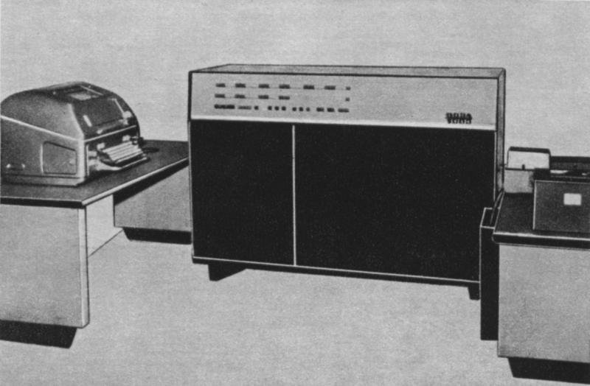
The very beginning
The first Polish game was designed by Witold Podgórski on Odra computer in 1962

Slide 3
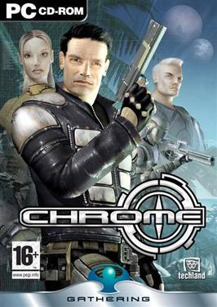


2000-2010
Chrome (2003)
Painkiller (2003)
Call of Juarez (2006)

Slide 4


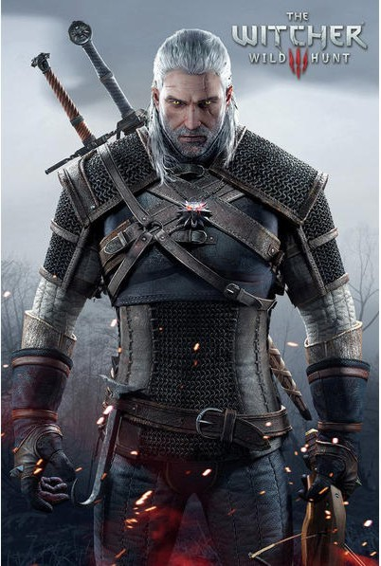
The Witcher series
The Witcher (2007)
The Witcher 2 (2011)
The Witcher 3 (2015)

Slide 5


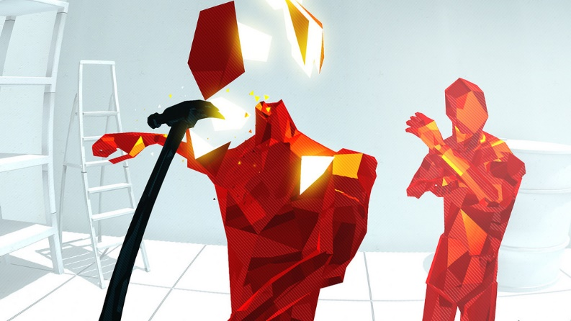
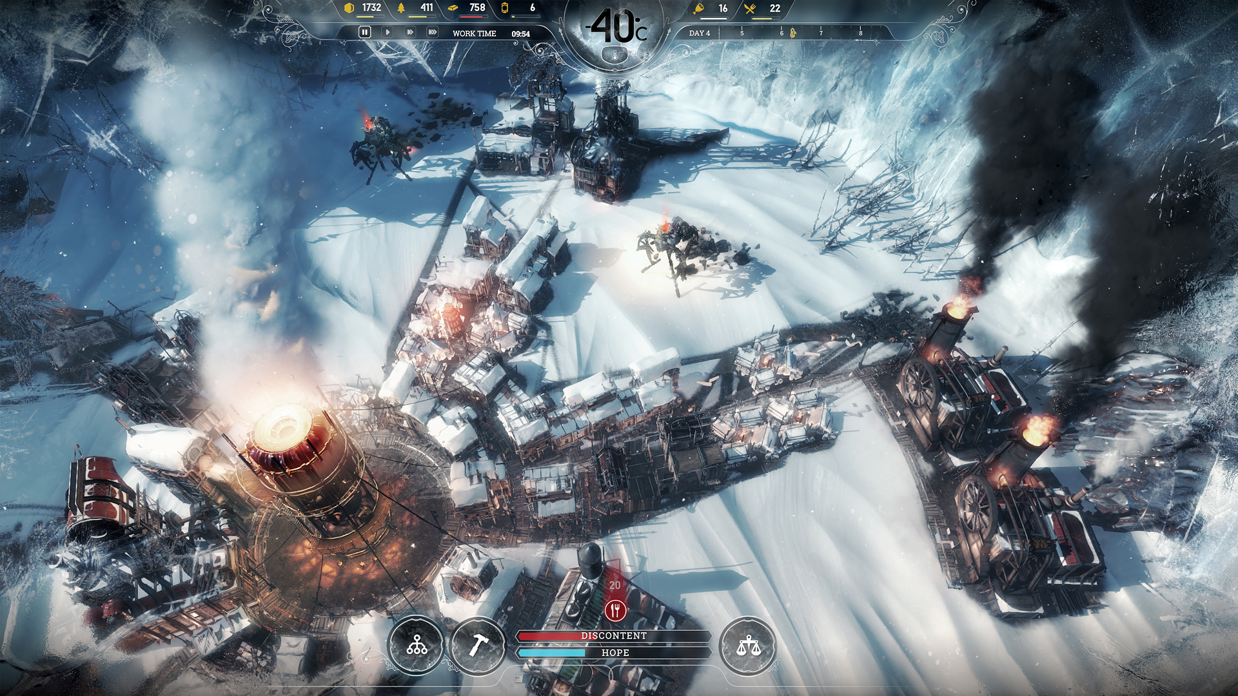



Recent hits

Slide 6

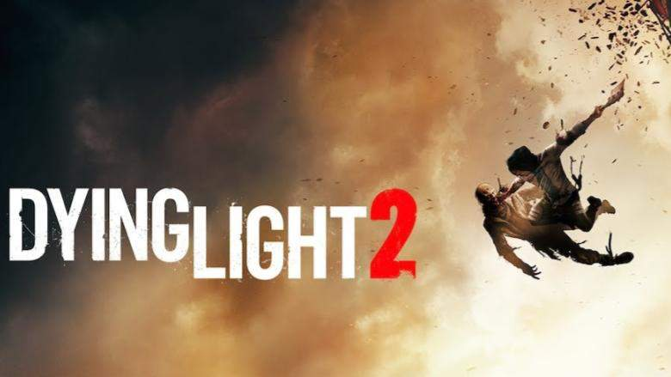
Future Polish hits
What next?

Slide 7

Career?
Investment/career opportunity?
Poland is the 23rd world’s largest video game producer
Polish video game market is worth $550 million
In 2 years the stock price of CDProjekt increased by 279%
In the same period the stock price of 11 bit studios rose by 142%
Many game developers are needed on the Polish job market – perhaps you should rethink your career direction

Slide 8
Thank you!
References
https://pl.wikipedia.org/wiki/Marienbad_(gra_komputerowa)
https://emerging-europe.com/intelligence/polish-gaming-sector-international-hit/
https://polandin.com/37971768/polands-video-game-market-growing-faster-than-in-eu

